Slide 1



.NET Conf 2024 - Vietnam
Organized by

Slide 2
Gain deeper understanding of ASP.NET Core by exploring its source code
Thien Nguyen

Slide 3
ASP.NET Core components
Application Startup
The Anatomy of a Request
Agenda
Routing
Authentication and Authorization
Exception Handling

Slide 4
Extensions
Web UI
Services
Extensions
Web UI
Services
MVC
Razor Pages
SPA
Blazor
HTTP APIs
SignalR
gRPC
Logging
Configuration
Middleware
Middleware
Routing
Security
Localization
Caching
Options
Compression
Session
Health Checks
…
File Providers
Servers
Worker
Services
Servers
Worker
Services
Kestrel
IIS
HTTP.sys
Dependency Injection
Hosting
Hosting
ASP.NET Core Components

Slide 5
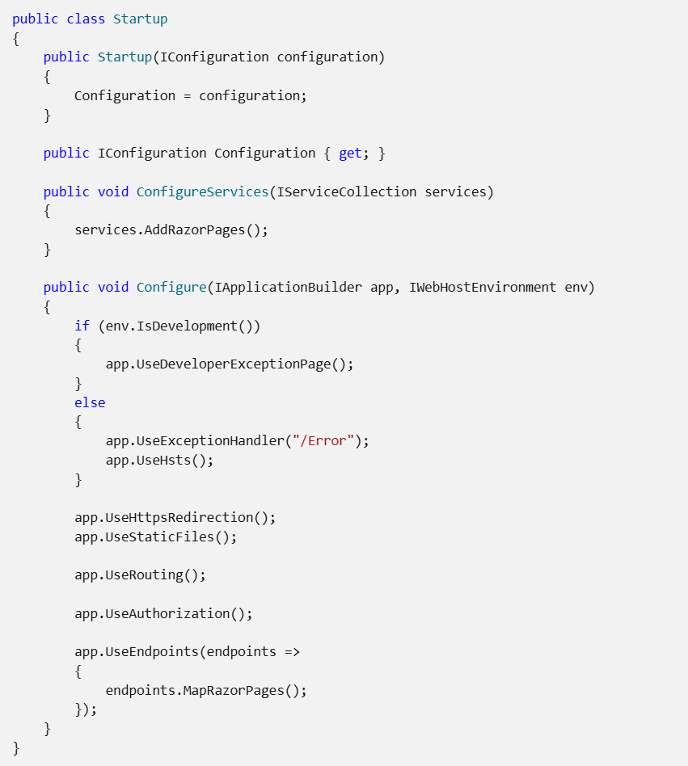
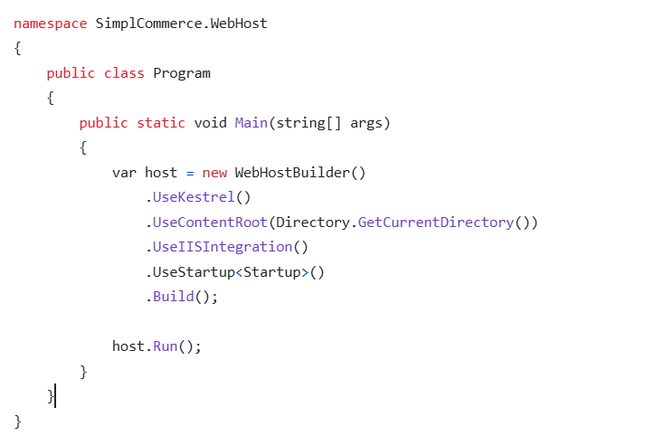
Application Startup
https://github.com/dotnet/aspnetcore/blob/main/src/DefaultBuilder/src/WebApplicationBuilder.cs

Slide 6
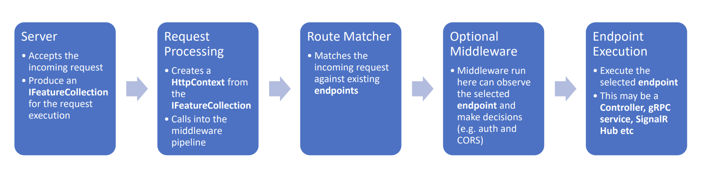
The Anatomy of a Request

Slide 7
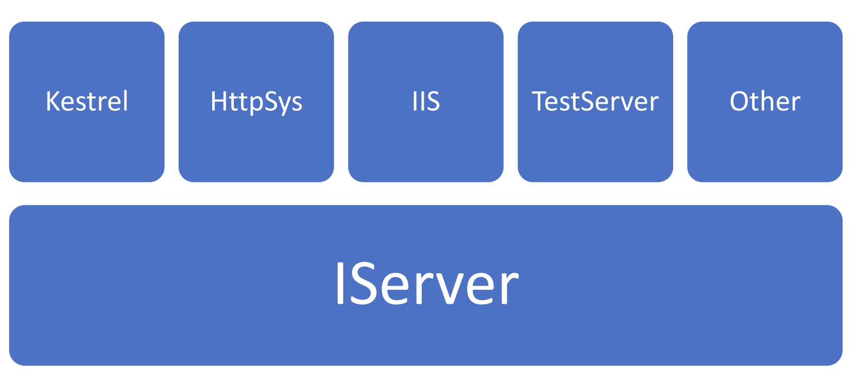
The Server Architecture

Slide 8
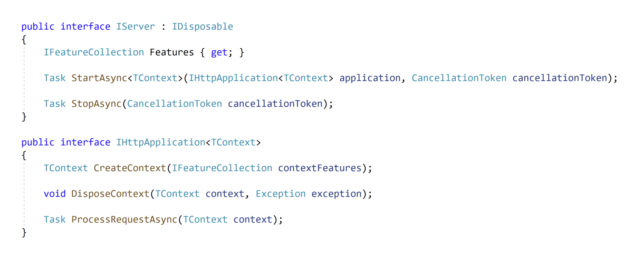
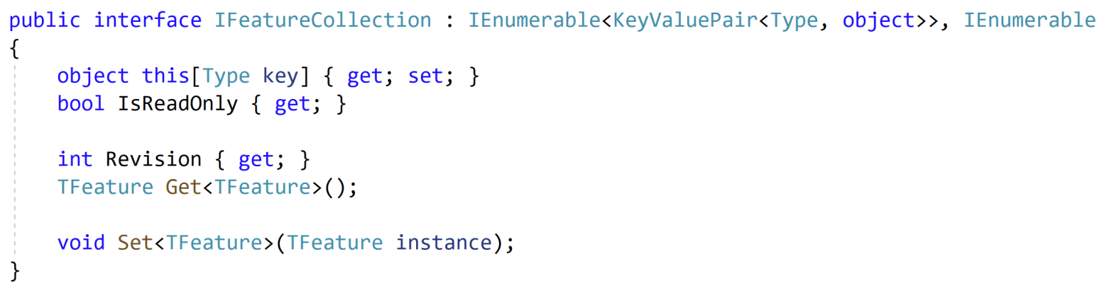
https://github.com/dotnet/aspnetcore/blob/main/src/Hosting/Server.Abstractions/src/IServer.cs
https://github.com/dotnet/aspnetcore/blob/main/src/Extensions/Features/src/IFeatureCollection.cs

Slide 9
Request Dispatching
Thread Pool
Request
Work Item
Thread
Request
Work Item
Infinity loop
Work Item
Thread
Request
ThreadPool.UnsafeQueueUserWorkItem
Work Item
Thread
Work Item
Work Item
Thread
https://github.com/dotnet/aspnetcore/blob/main/src/Servers/Kestrel/Core/src/Internal/ConnectionDispatcher.cs

Slide 10
HttpContext
HttpContext encapsulates all HTTP-specific information about an individual HTTP request.
HttpContext isn't thread-safe
https://github.com/dotnet/aspnetcore/blob/main/src/Http/Http/src/DefaultHttpContext.cs
https://docs.microsoft.com/en-us/aspnet/core/fundamentals/http-context
https://github.com/davidfowl/AspNetCoreDiagnosticScenarios/blob/master/AspNetCoreGuidance.md

Slide 11
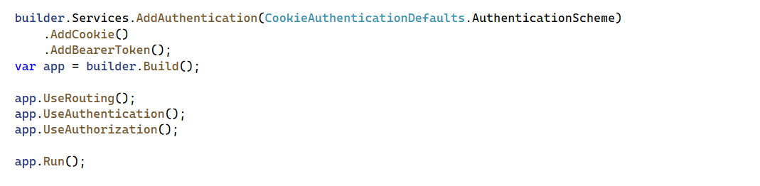
Authentication
https://github.com/dotnet/aspnetcore/tree/main/src/Http/Authentication.Abstractions/src
https://github.com/dotnet/aspnetcore/tree/main/src/Http/Authentication.Core/src
https://github.com/dotnet/aspnetcore/blob/main/src/Security/Authentication/Core/src/

Slide 12
Authentication
Support multiple Schemes: Cookies, Bearer, Windows,…
If only one scheme registered, it is automatically used as DefaultScheme
An Authentication Scheme corresponding to an Authentication Handler
https://github.com/dotnet/aspnetcore/blob/main/src/Http/Authentication.Abstractions/src/IAuthenticationHandler.cs
https://github.com/dotnet/aspnetcore/blob/main/src/Http/Authentication.Core/src/AuthenticationService.cs
https://github.com/dotnet/aspnetcore/blob/main/src/Security/Authentication/Core/src/AuthenticationMiddleware.cs
https://github.com/dotnet/aspnetcore/blob/main/src/Http/Authentication.Abstractions/src/AuthenticationHttpContextExtensions.cs
https://github.com/dotnet/aspnetcore/blob/main/src/Security/Authentication/Cookies/src/CookieAuthenticationHandler.cs

Slide 13
Authorization
AuthorizeAttribute only a marker attribute, it does not contain behavior, authentication is handled in AuthorizationMiddleware and AuthorizationFilter (legacy)
AuthoriztionPolicy contains a list of Requirements
Each Requirement need one or more AuthenticationHander
AuthorizationService: authorize the current user again Requirements
Role and Claim are built-in policies
https://github.com/dotnet/aspnetcore/blob/main/src/Security/Authorization/Core/src/AuthorizeAttribute.cs
https://github.com/dotnet/aspnetcore/blob/main/src/Security/Authorization/Policy/src/AuthorizationMiddleware.cs
https://github.com/dotnet/aspnetcore/blob/main/src/Security/Authorization/Core/src/DefaultAuthorizationService.cs

Slide 14
Custom Authorization Policy Provider
Typically, when using policy-based authorization, policies are registered by calling AuthorizationOptions.AddPolicy as part of authorization service configuration.
In some scenarios, it may not be possible (or desirable) to register all authorization policies in this way. In those cases, you can use a custom IAuthorizationPolicyProvider to control how authorization policies are supplied
https://github.com/thiennn/aspnetcore-samples/tree/main/CustomAuthorizationPolicyProvider

Slide 15
Global Exception Handling
Don’t write your custom ExceptionHandlerMiddleware
Use built-in ExceptionHanlderMiddleware and write your GlobalExceptionHandler that implement IExceptionHandler if needed.
https://github.com/dotnet/aspnetcore/blob/main/src/Middleware/Diagnostics/src/ExceptionHandler/ExceptionHandlerMiddlewareImpl.cs

Slide 16
Source code of demo
https://github.com/thiennn/aspnetcore-samples

Slide 17
Thank you

